Slide 1
Repetition Structures / Loops

Slide 2
Outline
Introduction
While loops
  Three types of while loops
Do-while loops
For loops
Nested loops

Slide 3
Why Need Loops ?
Suppose we want to add five numbers and find the average.
From what you have learned so far, you could proceed as follows
  scanf(“%d %d %d %d %d”, &iNum1, &iNum2, &iNum3, &iNum4, &iNum5);
  iSum = iNum1 + iNum2 + iNum3 + iNum4 + iNum5;
  fAverage = iSum / 5;
If 100 numbers, 1000 numbers?

Slide 4
Repetition (Loop)
Three statements can be used to implement loops in C
  while statement
  do-while statement
  for statement
while and for statements are similar in implementation, but have different syntax
The do-while statement is different - the following code is executed at least once

Slide 5
The while loop structure
The general form of the while statement is:
  while (expression)
  statement;
while loop repeats until condition becomes false

Slide 6
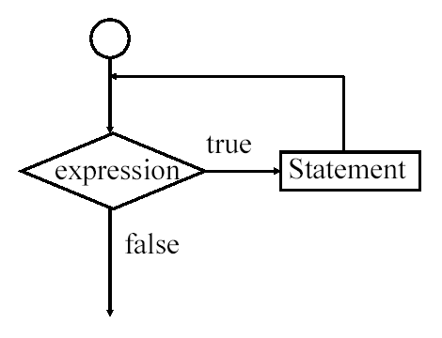
Flowchart of a while statement

Slide 7
The while loop structure-cont
There are basically three types of while loops:
  Counter-controlled while loop
  Sentinel-controlled while loop
  Flag-controlled while loop

Slide 8
Counter-Controlled while Loops
Definite repetition: know how many times loop will execute
Control variable used to count repetitions
Example:
int iCounter = 1;
while ( iCounter <= 10 )
{
    printf( "%d\n", iCounter );
    iCounter++;
    }

Slide 9
Counter-Controlled while Loops
Another example:
    int iProduct = 2;
    while ( iProduct <= 1000 )
    iProduct = 2 * iProduct;
true
iProduct <= 1000
iProduct = 2 * iProduct
false

Slide 10
Sentinel-Controlled while Loops
Indefinite repetition
Used when number of repetitions not known and loop needs to input value repeatedly for each iteration
Sentinel value indicates "end of data“

Slide 11
Sentinel-Controlled while Loops-continued
  Example:
  int iNumber;
  printf(“To stop enter -999. Enter positive numbers : " );
  scanf(“%d”, &iNumber);
  while (iNumber != -999)
  {
  printf(“To stop enter -999. Enter positive numbers : " );
  scanf(“%d”, &iNumber);
  printf(“%d”, iNumber);
  }

Slide 12
If CGPA>2.0 then pass, other than that, fails
Another example:
    float fGradePt;
    char cChoice;
    printf(“Continue? y-yes n-no: ”);
    scanf(“%c”, &cChoice);
    while ( cChoice == ‘y’)
    { printf(“\nEnter grade point:”);
    scanf(“%f”, &fGradePt);
    if(fGradePt > 2.0)
    printf(“\nPass);
    printf(“Continue? y-yes n-no: ”);
    scanf(“%c”, &cChoice);
    }

Slide 13
Flag-Controlled while Loops
Uses a flag to control the loop.
Loop exit when expression is evaluated to false.
int error;
int iGuess;
while (error)
{
printf("Enter number between 1 and 200:");
scanf("%d", &iGuess);
if ((iGuess>= 88) &&(iGuess <=128))
{
error = 0;
printf("\nBINGO!");
}
}

Slide 14
The do-while Repetition Structure
Similar to the while structure
Condition for repetition is tested after the body of the loop is performed
All actions are performed at least once
Expression can be written as count-controlled or sentinel-controlled
Format:
    do {
    statement;
    } while ( condition );

Slide 15
Flowchart of a do-while structure
action(s)
true
condition
false

Slide 16
The do-while Repetition Structure
Example : prints the integers from 1 to 10
int iCounter = 1;
do {
printf( "%d ", iCounter );
} while (++iCounter <= 10);
Another example:
do {
    printf(“\nEnter grade point:”);
    scanf(“%f”, &fGradePt);
    if(fGradePt > 2.0)
    printf(“\nPass);
    printf(“Continue?y-yes n-no :”);
    scanf(“%c”, &cChoice);
    }while ( cChoice == ‘y’)
count-controlled
sentinel-controlled

Slide 17
The do-while Repetition Structure
To avoid an infinite loop, make sure that the loop body contains a statement that ultimately makes the expression false and assures that it exits
Another example:
int iLoop = 0;
do
{
  printf (“%d ”,iLoop);
  iLoop = iLoop + 5;
} while (iLoop <= 20);
The output is:
0 5 10 15 20

Slide 18
The do-while Looping Structure (Example)
Example: Consider the following two loops
(a)
iLoop = 11;
while (iLoop <= 10)
{
printf("%d",iLoop);
iLoop = iLoop + 5;
}
(b)
iLoop = 11;
do
{
printf("%d",iLoop);
iLoop = iLoop + 5;
}
while (iLoop <= 10);

Slide 19
The do-while Looping Structure (Example)
In (a), the while loop, produces nothing
In (b) the do...while loop, outputs the number 11

Slide 20
The for Repetition Structure
Format when using for loops
for (initialization ; loop continuation test ; increment statement)
Use for loops when already know how many times to repeat
Example:
for(iCounter = 1;iCounter <= 10;iCounter++)
    printf("%d\n",iCounter);
  Prints the integers from 1 to 10

Slide 21
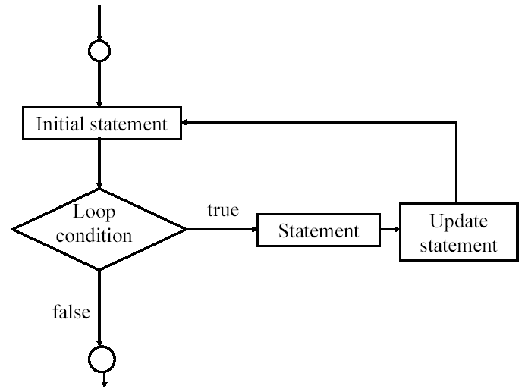
Flow of a for statement

Slide 22
Nested loop
Loop within a loop
Inner loop is performed first
e.g.
for(iLoop1=1;iLoop1<4;iLoop1++)
{
for(iLoop2=1;iLoop2<5;iLoop2++)
printf(“%d”, iLoop2);
printf(“\n”);
}
Output
1234
1234
1234

Slide 23
Nested loop
Another example:
  Program finds and prints avg of three test scores, then asks whether user wants to continue
do
{
for(iCount=0; iCount <3;iCount++)
{ printf(“\nEnter test marks: ”);
scanf(“%d”, &iMarks);
iTotal=iTotal+iMarks;
}
fAvg=iTotal/iCount;
printf(“\nAverage:%5.2f”, fAvg);
printf(“\nContinue?”);
scanf(“%c”, &cChoice);
}while(cChoice == ‘y’);

Slide 24
End - Loops
Q & A!

